Slide 1
How To Achieve CI/CD Using TestProject & Jenkins

Slide 2
Achieve CI/CD Using TestProject & Jenkins
Walkthrough Page Object Model
Install Plugins For TestProject, TestNG, & Gradle
Set Up Pipeline Environment
Pull Test From Git
Run The Test
Rex Jones II

Slide 3
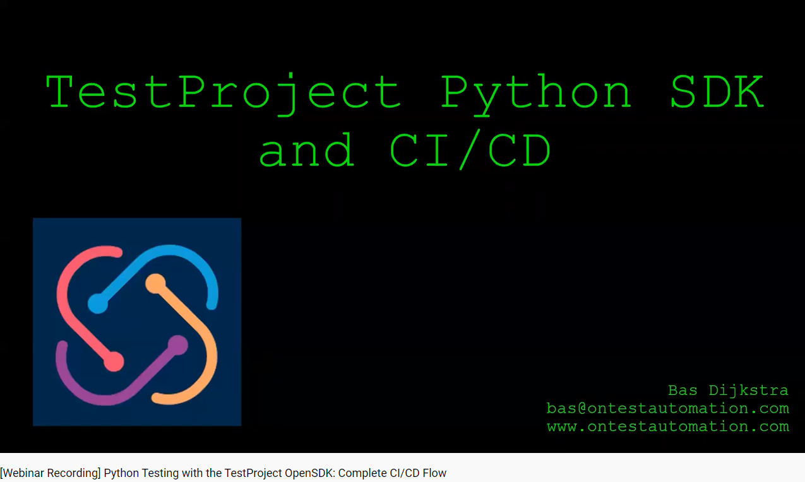

Slide 4
Page Object Model

Slide 5
Install Plugins

Slide 6
Set Up Pipeline Environment

Slide 7
Pull Test From Git

Slide 8
Run The Test

